Slide 1
Workflow23
Inception Deck by Nathan 03/02/23

Slide 2
Agenda
We are the best stack visualisation tool.

Slide 3
Why do an Inception Deck?
An inception deck helps us as a team to be aligned in our thinking and expectation setting. All too often we assume there is consensus when none exists.
An inception deck helps us to get that consensus, so we aren’t thinking triangles and circles - we are all thinking circles.
Powered by Agile Warrior: https://agilewarrior.wordpress.com/2010/11/06/the-agile-inception-deck/

Slide 4
Why are we here?
We are the best stack visualisation tool.
The product helps teams visualise their workflows and run them from one dashboard.
We can’t build a great ‘thing’ if we don’t know why we are building it in the first place. So ‘why we are here’ helps us to make all those smart decisions while we are executing.
Powered by Agile Warrior: https://agilewarrior.wordpress.com/2010/11/06/the-agile-inception-deck/

Slide 5
Elevator
Pitch
Who companies who want to visualise and manage their software infrastructure.
The Workflow23 dashboard
Is a microservice visualisation and CI/CD monitoring tool.
That allows companies to visualise their infrastructure runtime and dependencies
Unlike confluence
Our ‘thing’ also shows you the status of the running program
An Elevator Pitch tells people what your product is, who it is for, and why it’s special in about the time it takes a ride in an elevator.
Powered by Agile Warrior: https://agilewarrior.wordpress.com/2010/11/06/the-agile-inception-deck/

Slide 6
What is it!? Box
- Shows you which parts of the infrastructure are running in real time
- Maps knowledge and workflows in your organisation
- Visualise your Docker containers
What are the top three reasons people are going to use this ‘thing’?
And if there was one slogan that captured the spirit of this thing, what would it be?
Powered by Agile Warrior: https://agilewarrior.wordpress.com/2010/11/06/the-agile-inception-deck/

Slide 7
Create a Not List
- Host your workflows
- Add comments / annotations
- Autosave documents (not enough time this weekend)
Saying ‘yes’ is easy. So what aren’t we going to do?
Powered by Agile Warrior: https://agilewarrior.wordpress.com/2010/11/06/the-agile-inception-deck/

Slide 8
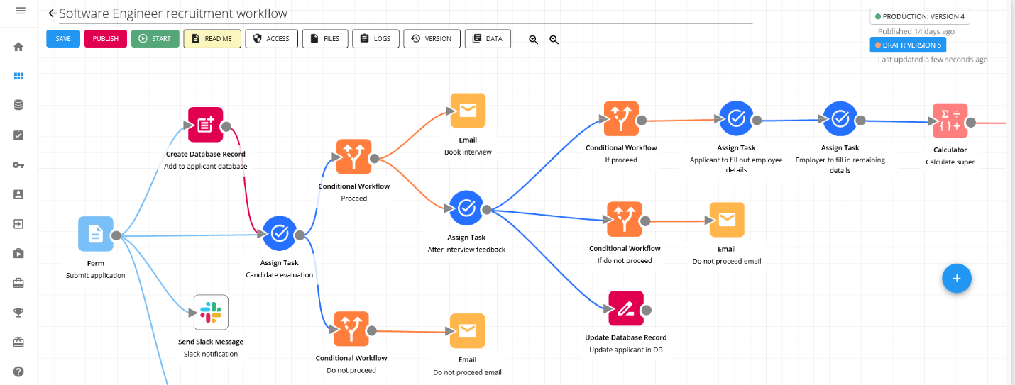
IN SCOPE
OUT OF SCOPE
- Template for Workflow23 stack (python django, react, docker)
- Canvas to create workflows
- Notify when python task is running
-
- Host your workflows
- Add comments / annotations
- Autosave documents (not enough time this weekend)
- Graph workflows
UNRESOLVED

Slide 9
Meet your neighbours
Workflow86
As part of our journey we need to think about our wider community.
Powered by Agile Warrior: https://agilewarrior.wordpress.com/2010/11/06/the-agile-inception-deck/

Slide 10
What keeps you up at night?
NOT DONE
Mitigation:
Impact: Likelihood:
<ENTER FAVOURITE RISK>>
Mitigation:
Impact: Likelihood:
<ENTER FAVOURITE RISK>>
Mitigation:
Impact: Likelihood:
<ENTER FAVOURITE RISK>>
Mitigation:
Impact: Likelihood:
We all know things can go wrong, some we can handle and some we can’t.
Let each other know what keeps you up at night (i.e. the risk), so we can work out whether they are worth while worrying about or not to sweat them.
<ENTER FAVOURITE RISK>>
Mitigation:
Impact: Likelihood:
<ENTER FAVOURITE RISK>>
Mitigation:
Impact: Likelihood:
Powered by Agile Warrior: https://agilewarrior.wordpress.com/2010/11/06/the-agile-inception-deck/

Slide 11
Size it up
React app with a few pages:
- One template
- Canvas page(s) you can save
- See your saved canvases
Python pipeline:
- Run python task(s)
- Notify server on task start / completion / error
Django REST server:
- Polled by react app on status whilst running
This exercise is about answering the question: is it bigger than a breadbox? We can’t exactly say how many days it’s going to take to do this project up front. But we can say whether it’s a 3, 6 or 8 week’er.
Powered by Agile Warrior: https://agilewarrior.wordpress.com/2010/11/06/the-agile-inception-deck/
Notes:
To do this exercise you’ll need to do some high-level story planning and estimation. The NOT list will serve you well here. And you will need to come up with some high-level numbers to at least give your stakeholders some idea of how big this thing is and what they are looking at.
The point here isn’t precision. It’s to determine whether this project is even remotely feasible with the resources you’ve got.

Slide 12
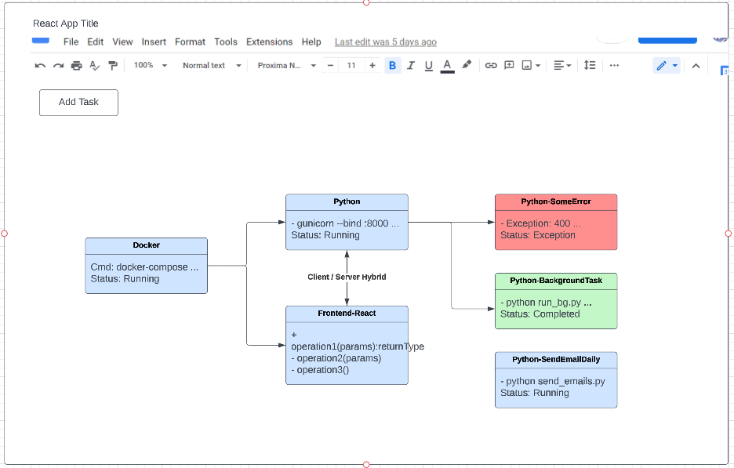
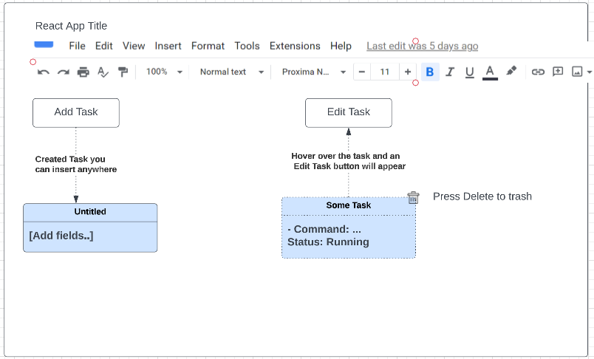
Template
Canvas Page
Wireframe
https://lucid.app/lucidchart/0c051d0a-6030-4f39-8917-b063b70500b8/edit?viewport_loc=-345%2C-124%2C2994%2C1495%2C0_0&invitationId=inv_48bce26d-d1fd-48b8-b948-c6eb2df79867

Slide 13
What do we need to get this project started?
I’m coding it over Friday – the weekend and deploying it

Slide 14
Thanks for your time today!

